Slide 1

Delegates AND Events

Slide 2
Agenda
Overview
Common Scenarios
Delegates
Events

Slide 3
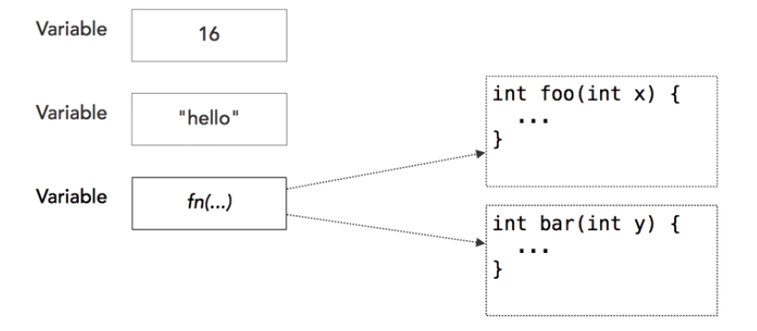
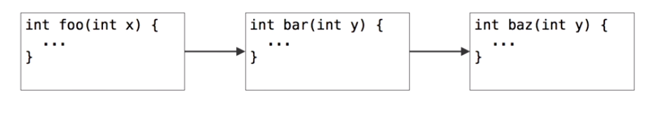
Overview of Delegates
Delegates: Placeholders for functions
Delegates can be dynamically chained together
Notes:
What is a delegate
A delegate is a type safe function pointer.
That is, it holds a reference(pointer) to a function
The signature of the delegate must match the signature of the function, the delegate points to, otherwise you get a compiler error.
This is the reason delegates are called as type safe function pointers.
A delegate is similar to a class. You can create an instance of it, and when you do so, you pass in the function name as a parameter to the delegate constructor, and it is to this function the delegate will point to.

Slide 4
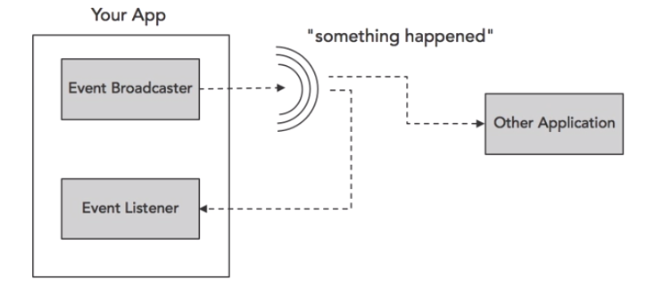
Overview of Events
Used to broadcast and listen to messages

Slide 5
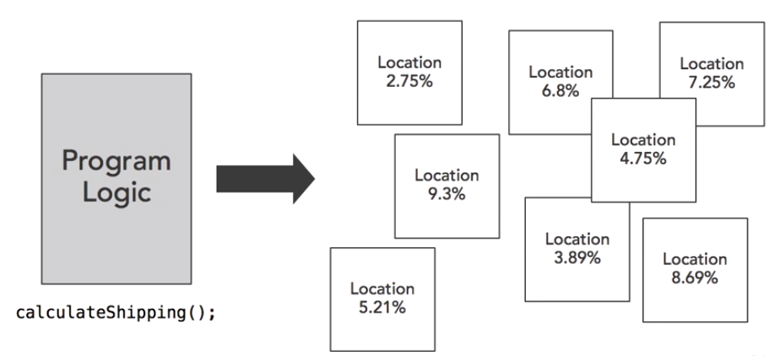
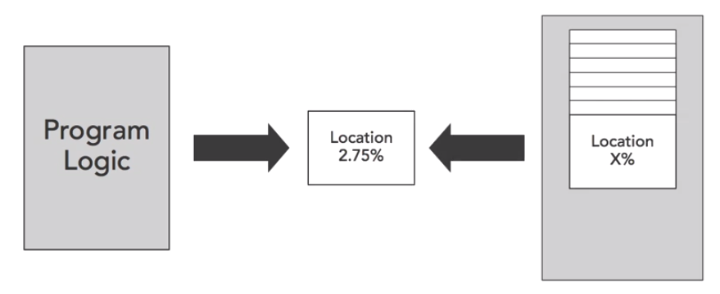
Common business scenarios
Shipping Company which ships items to multiple locations and have to calculate fee as per location

Slide 6
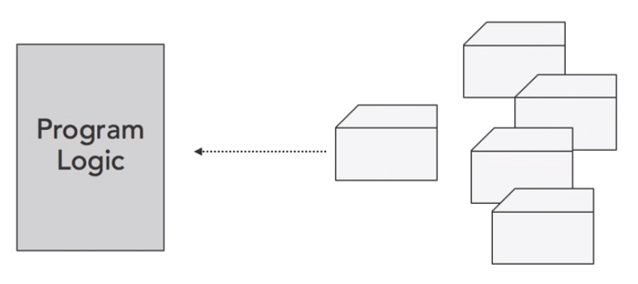
Common business scenarios
Identify the change of contents in folder
Identify the change in user input or button click in web dev

Slide 7
Delegates
Notes:
What is a delegate
A delegate is a type safe function pointer.
That is, it holds a reference(pointer) to a function
The signature of the delegate must match the signature of the function, the delegate points to, otherwise you get a compiler error.
This is the reason delegates are called as type safe function pointers.
A delegate is similar to a class. You can create an instance of it, and when you do so, you pass in the function name as a parameter to the delegate constructor, and it is to this function the delegate will point to.

Slide 8
What is callback?
Task: copy file with process indicator
Solution: create interface IProgressIndicator
public interface IProgressIndicator { void Progress(string message, int progressPercentage); }
public class WriteLogToConsole : IProgressIndicator { public void Progress(string message, int progressPercentage) { Console.WriteLine("{0} ({1}%) - {2}", DateTime.UtcNow, progressPercentage, message); } }

Slide 9
What is callback?
static public void Copy(string srcPath, string dstPath, IProgressIndicator progressIndicator) { var fi = new FileInfo(srcPath); var srcFile = new FileStream(srcPath, FileMode.Open); var dstFile = new FileStream(dstPath, FileMode.CreateNew); byte[] buffer = new byte[bufferSize]; int readedSize; int step = 0; progressIndicator.Progress("Start copy", 0); do { readedSize = srcFile.Read(buffer, 0, bufferSize); dstFile.Write(buffer, 0, bufferSize); step++; progressIndicator.Progress("Progress copy", (int) fi.Length / (step * readedSize)); } while (readedSize != 0); progressIndicator.Progress("Finish copy", 100); }

Slide 10
From interface to delegate
Interface disadvantages
Complex (we need create class for realization)
As alternative – use delegates
interface ITransformer { int Transform(int x); }
delegate int Transform(int x);

Slide 11
Use delegates
delegate int Transform(int x);
[TestClass] public class SimpleDelegateSample { static int Square(int x) { return x * x; } static int Add(int x) { return x + x; } static int DoubleTransform(int x, Transform trans) { return trans(trans(x)); } [TestMethod] public void TransformTest() { Transform t = Square; // Create delegate instance
var result = t(3); // Invoke delegate var result2 = t.Invoke(5); // Invoke delegate
var result3 = DoubleTransform(6, Add); // Delegate as parameter
Console.WriteLine("{0} {1} {2}", result, result2, result3); } }

Slide 12
Multicast delegates
delegate void ProgressDelegate(string message, int progressPercentage); void WriteProgressToFile(string message, int progressPercentage) { File.AppendAllText(/* */); } void WriteProgressToConsole(string message, int progressPercentage) { Console.WriteLine(/* */); } void ProgressEmulator(ProgressDelegate progress) { int stepCount = (int)(new Random(new TimeSpan().Seconds).NextDouble() * 10); progress("Start", 0); for (int step = 0; step < stepCount; step++) { progress("Progress", (int)(step * 100 / stepCount)); System.Threading.Thread.Sleep(100); } progress("Finish", 100); }
ProgressDelegate p = null; p += WriteProgressToConsole; p += WriteProgressToFile; ProgressEmulator(p);

Slide 13
Multicast delegates
delegate int ValueDelegate();
Disadvantages
Only one (last) return value
Break execution all delegates if one throw exception
ValueDelegate d = null; d += A1; d += A2; d += A3; Console.WriteLine(d());
ValueDelegate d = null; d += A1; d += A2; d += A3; foreach (ValueDelegate t in d.GetInvocationList()) { Console.WriteLine(t()); }

Slide 14
Multicast delegates with ref
static void func1(int arg1, ref int arg2)
{
int result = arg1 + arg2;
arg2 += 20;
}
static void func2(int arg1, ref int arg2)
{
int result = arg1 * arg2;
}
Use ref variables to pass results from one delegate to other
int a = 10, b = 10;
MyDelegate f1 = func1;
MyDelegate f2 = func2;
MyDelegate combined = f1 + f2;
combined(a, ref b);

Slide 15
Anonymous delegates
delegate void WithoutReturn(int x);
delegate int WithReturn(int x);
WithoutReturn p = delegate (int x) { Console.WriteLine(x); }; WithReturn p2 = delegate (int x) { return x * x; };
Notes:
List.Find()

Slide 16
Static vs. Instance delegates
void InstanceDelegate() { this.Property = ""; } static void StaticDelegate() { // Can't call instance property }
public void CreateDelegateInInstanceMember() { MyDelegate p1 = InstanceDelegate; MyDelegate p2 = StaticDelegate; }
public static void CreateDelegateInStaticMember() { var t = new StaticVsInstance(); MyDelegate p1 = t.InstanceDelegate; MyDelegate p2 = StaticDelegate; }

Slide 17
When to use Delegates ?
Notes:
An eventing design pattern is used.
The caller has no need to access other properties, methods, or interfaces on the object implementing the method.
A class may need more than one implementation of the method.
There is a group of related methods that may be called.
A class only needs one implementation of the method.

Slide 18
Events

Slide 19
Introduction to Events
public class Worker { public delegate void ProgressDelegate(int percentComplete); public event ProgressDelegate Progress; public void DoWork() { for (int i = 0; i < 10; i++) { Progress(i * 10); System.Threading.Thread.Sleep(100); } } }
public void TestMethod1() { var worker = new Worker(); worker.Progress += worker_Progress; worker.DoWork(); } private void worker_Progress(int percentComplete) { Console.WriteLine(percentComplete); }

Slide 20
BCL recommendations for Events
public class WorkerProgressArgs { public int ProgressPercent { get; internal set; } } public event EventHandler<WorkerProgressArgs> Progress; protected virtual void OnProgress(WorkerProgressArgs args) { var tmp = Progress; if (tmp != null) tmp(this, args); } public void DoWork() { for (int i = 0; i < 10; i++) { OnProgress( new WorkerProgressArgs { ProgressPercent = i * 10 }); System.Threading.Thread.Sleep(100); } }
public void TestMethod1() { var worker = new BCLWorker(); worker.Progress += worker_Progress; worker.DoWork(); } private void worker_Progress(object sender,
BCLWorker.WorkerProgressArgs e) { Console.WriteLine(e.ProgressPercent); }

Slide 21
Event chaining and unchaining
MyClass obj = new MyClass();
// Connect multiple event handlers
obj.valueChanged += changeListener1;
obj.valueChanged += changeListener2;
// Use an anonymous delegate as the event handler
obj.valueChanged += delegate(string s) {
Console.WriteLine("This came from the anonymous handler!");
};
obj.objChanged += delegate(object sender, ObjChangeEventArgs e) {
Console.WriteLine("{0} had the '{1}' property changed", sender.GetType(), e.propChanged);
};

Slide 22
THANKS

